Slide 1
Chapter 3
Software Development Platforms

Slide 2
Table of Contents
Introduction
Microcontroller Architecture
Software Development Platforms
Digital Input and Output
Interrupts and Power Management
Timing Operations
Conversion Between Analog and Digital Values
Digital Communication
Memory Operations
Real-time Operating Systems
LCD, Touch Screen, and Graphical User Interface Formation
Introduction to Digital Signal Processing
Introduction to Digital Control
Introduction to Digital Image Processing
Advanced Topics

Slide 3
LAYOUT
Introduction
The STM32CubeIDE Platform
  Downloading and Installing STM32CubeIDE
  Launching STM32CubeIDE
  Creating a New Project
  Building, Debugging, and Executing the Project
  Using STM32CubeMX to Modify Hardware of the Microcontroller
Mbed and Mbed Studio Platforms
  Mbed on Web
  Managing a Project in Mbed
  Mbed Studio on Desktop
  Managing a Project in Mbed Studio
MicroPython
  About Python
  Python for Microcontrollers, MicroPython
  Setting up MicroPython on the STM32F4 Microcontroller
  MicroPython Working Principles
  Using MicroPython on the STM32F4 Microcontroller

Slide 4
Introduction
The microcontroller itself is of no use without being programmed.
This can be done using an integrated development environment (IDE) working on PC.
We will benefit from STM32CubeIDE for C language-based programming.
We will use Mbed and Mbed Studio platforms for C++ language-based programming.
We will use MicroPython as the dedicated implementation of Python language for microcontrollers.

Slide 5
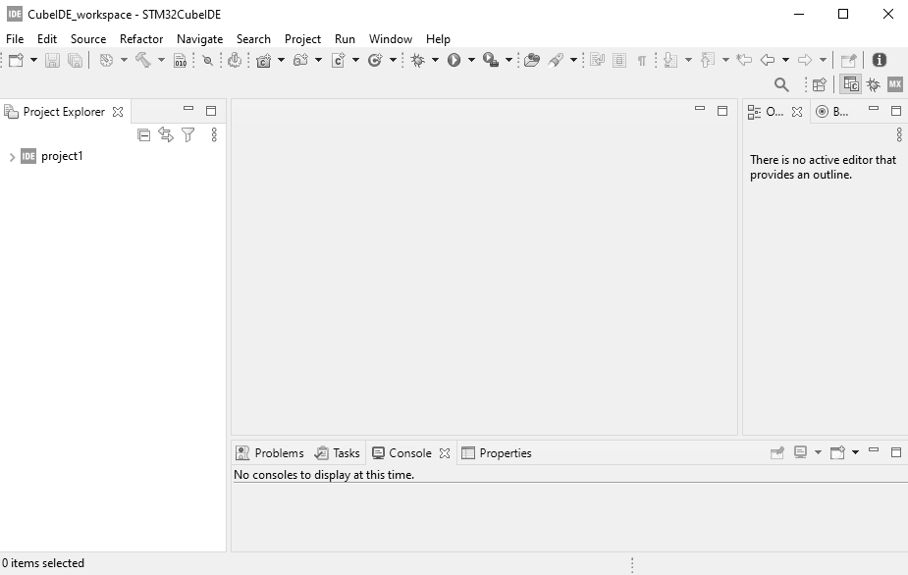
The STM32CubeIDE Platform
STM32CubeIDE welcome window.

Slide 6
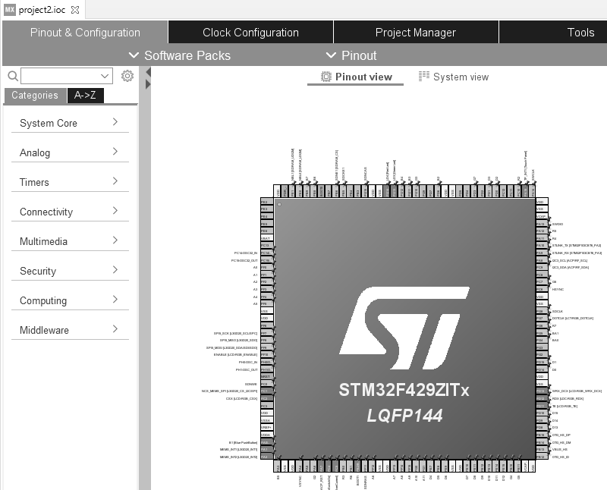
The STM32CubeIDE Platform
Initial screen for STM32CubeMX.

Slide 7
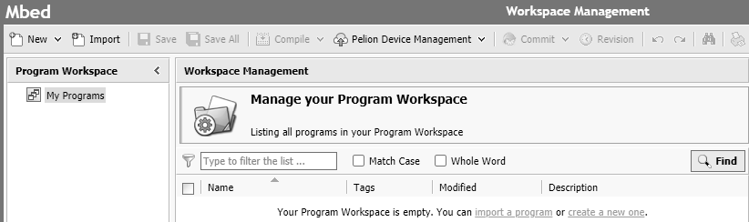
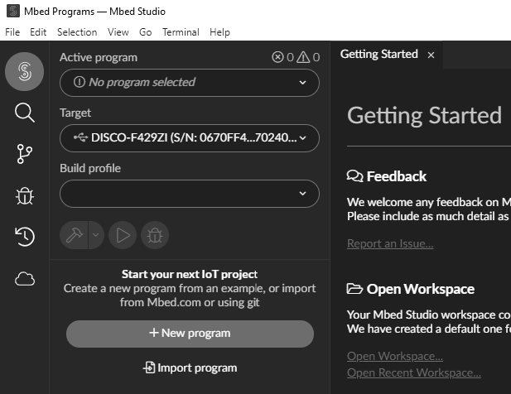
Mbed and Mbed Studio Platforms
Online Mbed compiler
Mbed Studio launch window

Slide 8
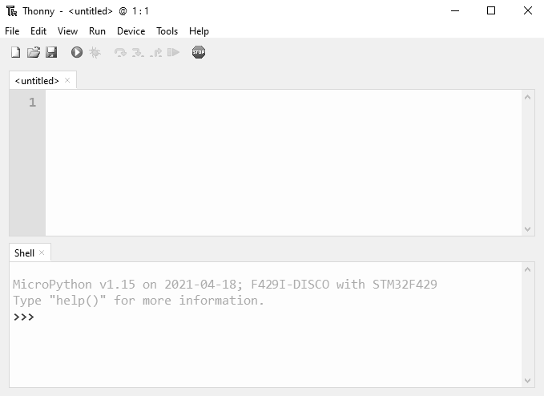
MicroPython
Thonny, MicroPython command execution on the shell

